Slide 1

Large Language Models
By Shaan Malik

Slide 2
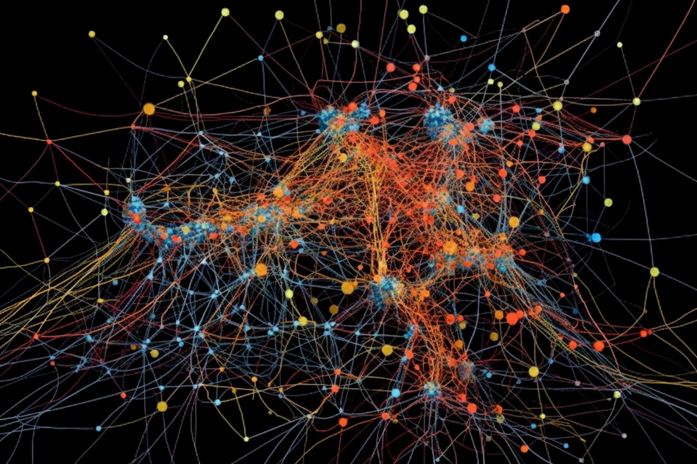
What is a Language Model?
It is a computer program that completes sentences for you and generates words
Example : “It's raining cats and …”
Notes:
First let's talk about what a language model is. It is a computer program that completes sentences for you and generates words. For example: if you give the model the sentence “its raining cats and…” it will complete the sentence with dogs at the end because it has seen that combination over and over again during its training.

Slide 3
Large Language Model
It is called a large language model because it has been trained on massive amounts of data and that data is mostly from the internet.
There are about 178 Million Words in 1 GB
There are about 1 Million GB’s in 1 Petabyte
The text data that Large Language Models are trained on can be petabytes in size

Slide 4
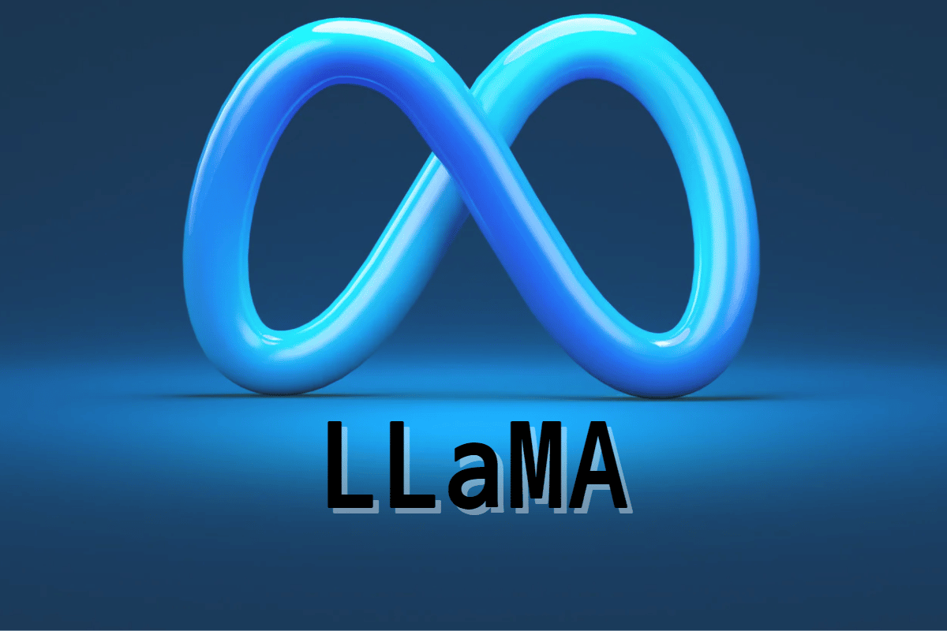
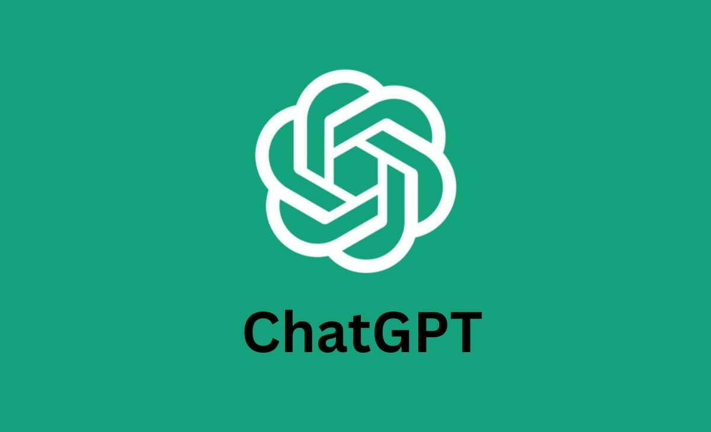

Examples of Large Language Models :
ChatGPT by OpenAI
Bard by Google
Llama by Meta

Slide 5

Why are Large Language Models Useful?
Large language models have already come a long way and are useful in a lot of cases. Large language models can be useful by :
Translating languages
Answer Questions
Code Generation/Programming Help
Own personal tutor
Implemented in search engines

Slide 6
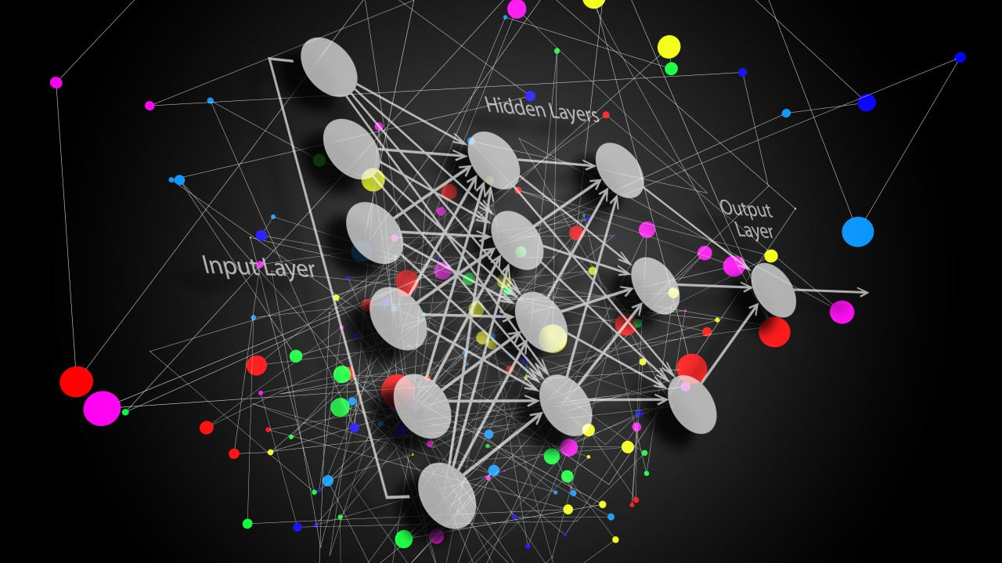
Industries to benefit from Large Language Models :
Information Technology
- Chatbots
- Software engineering
- Data structuring

Slide 7
Industries to benefit from Large Language Models :
Business
Allowing for increased sales productivity
Automation
Data analysis

Slide 8
Industries to benefit from Large Language Models :
Education
Allow for students to learn a lot easier
Gives everyone access

Slide 9
Risks of Large Language Models :
There have been hacking communities that have been using large language models like chat gpt to help them make tools and give them ideas on how to maliciously perform an attack.
Hackers can use large language models to send out sophisticated phishing emails to people
Hackers can use LLM’s to make malware

Slide 10
Risks of Large Language Models :
Misinformation can be spread all over the internet that is generated by large language models and can result in people believing in the lies and cause confusion among the general public
Large language models like chatgpt are known to make things up while sounding confident and legitimate while generating the misinformation.
LLM’s also tend to be bias sometimes because of their training data.

Slide 11
Future of Large Language Models :
The performance is continuously growing with more data added and more parameters
They will start to become more accurate over time
They will start to become more complex
They will impact even more industries

Slide 12

Questions?

Slide 13
Works Cited
How Large Language Models Work
https://www.credit-suisse.com/about-us-news/en/articles/news-and-expertise/chatgpt-the-potential-of-large-language-models-202303.html
https://www.wired.com/story/chatgpt-jailbreak-generative-ai-hacking/
https://snorkel.ai/large-language-models-llms/

